Slide 1
AgroServe
February 28, 2018

Slide 2
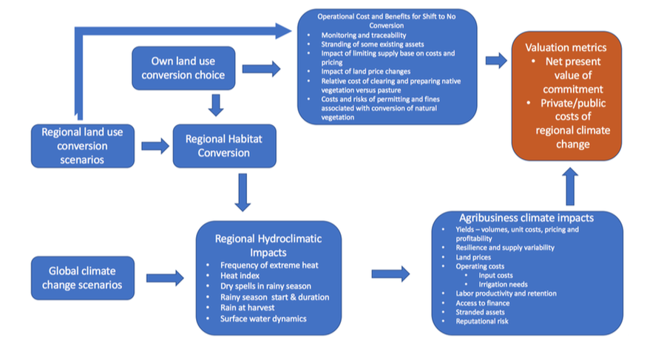

Slide 3
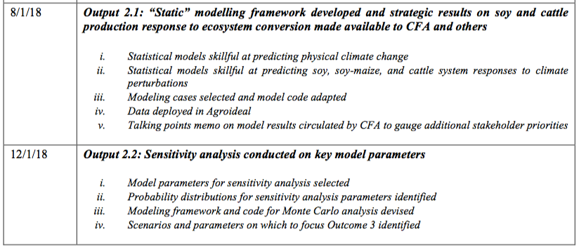
For summer: Output 2.1 by Aug 1?
Make the function hydroclimatic metric = f(precip, T, land use)
Will this function include global climate change scenarios?
Which metric to focus on?
rainy season and surface water dynamics ones are better connected to catchment classification stuff
Do this using statistical model only? Base the statistical model on literature?
Geographic and temporal scope of summer work? Downwind/downstream effects?
Are we trying to calculate the hydroclimate metrics both before and after land use change?

Slide 4
General clarifications
How is land use change defined for us?
Just deforestation for soybean, bean-maize, cattle?
How about specific agricultural practices?
How were the hydroclimatic metrics determined?
How to combine global climate change with land use effects in the statistical model?
How will the impacts of the hydroclimate metrics to agricultural production be modeled? Will it be based on lit review?
Scope
Consider downwind impacts on water availability from land use changes? What’s the physical area of the places we’re studying?
Time scope – i.e. will the project make predictions, and up to what year?
Will there be a lot of data gathering in addition to data analysis?
Who’s doing output 2.1, ii) statistical models skillful at predicting soy, maize, cattle system responses to climate perturbations?
Besides Earth Engine and Python, any statistics that I need to learn? What about regional climate knowledge like convection moisture pump, temperature gradient, etc?
UCB is doing sensitivity analysis in Output 2.2 – is this the most feasible option for the fall?

Slide 5
For fall & beyond
Add in soil moisture and ET to the statistical model of the hydroclimate metrics. Are they a better predictor than precipitation, temperature?
Smaller-scale land use changes that can impact hydroclimatic metrics
Irrigation practices, other agricultural practices – how they impact blue and green water resources
Small farm dams and its effect on evaporation
How do changes in regional hydroclimatic metrics affect irrigation needs?
Study the potential feedback mechanisms between irrigation as a LUC and the LUC’s impact on the need for more irrigation, on yield
Land use change
Hydroclimate metrics
Agribusiness outcomes
Dynamic model
Develop the statistical model to include more variables (s, ET)
Add in other LUCs that can impact metrics
How metrics impact irrig needs
Possible to work on this for irrigation?

Slide 6
For fall & beyond
Compare potential agricultural expansion practices (irrigation, crop intensification, deforestation, expansion into pastureland, rainwater harvesting) and their effect on green/blue water resources in the Amazon. Then, link changes in green/blue water resources to a change in yield (downstream/downwind?) under different global climate conditions.
Optimize some measure of food security using various global climate scenarios, our knowledge about the economic and environmental tradeoffs of deforestation, major food transportation networks, and constrained by feasible agribusiness practices in South America (or elsewhere). For a given country, crop, budget, population, environmental policy – what is the optimal agribusiness practice “mix” in each “region”?
Use the gathered data to look at historical spatial and temporal patterns in agricultural practice in South America (doesn’t have to be irrigation). Calculate some “social benefit” index across the studied area, accounting for the economic factors, expected yield, food security, environmental impact.

Slide 8
Learn Python, Google Earth Engine
https://developers.google.com/earth-engine/tutorials
https://developers.google.com/earth-engine/edu
https://developers.google.com/earth-engine/
Provide Avery Cohn timeline of development of ideas (i.e. when to get rough draft of papers)
Dave – ask about workflows, datasets, statistical models, potential project ideas
Prospectus for qual and connecting PhD to future project

Slide 9
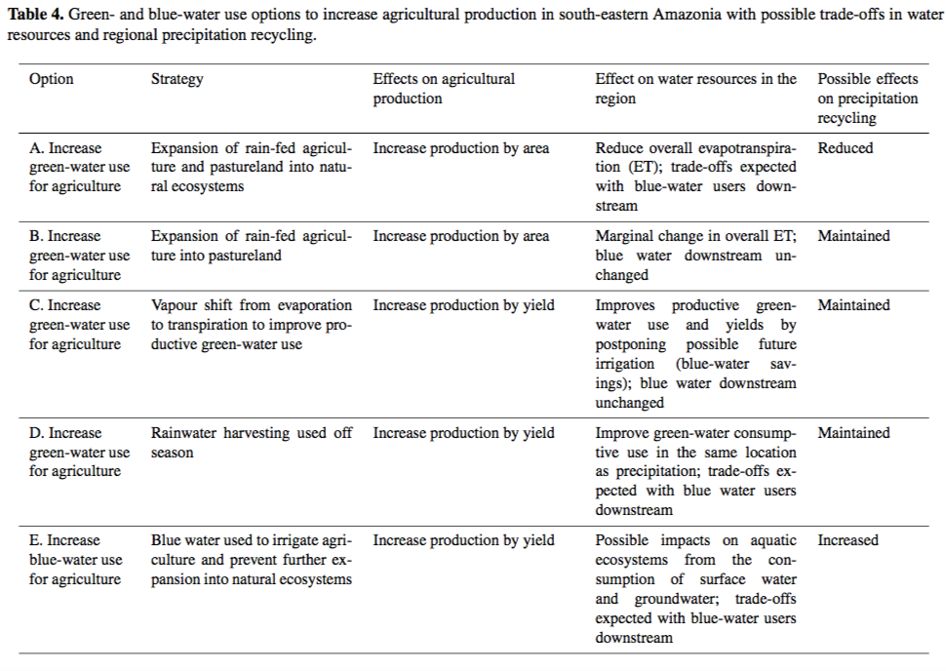
(Lathuilliere et al, 2016)
Looked at blue and green water for ag production. Precipitation recycling is important for blue and green water considerations; ET from upwind becomes precipitation downwind. This forms an “atmospheric watershed”, and green water sources recharge this watershed. Deforestation can decrease transpiration and therefore increase runoff. The expansion of irrigation can increase transpiration, so net change in ET is only slightly negative.
“vapor shift”: is decreasing unproductive green water (evaporation) and increasing transpiration (which is productive green water).
Looks at green and blue water tradeoffs in Amazonia.
Land use change also affects radiation partitioning and surface temperature.
They modeled 5 ways agriculture and irrigation could be expanded, like rainwater harvesting and vapor shift, and looked at tradeoffs with blue water users downstream.

Slide 10
(Wang et al, 2018)
Looked at downwind impacts on water availability from land use changes
Some areas are more sensitive to LUC because of land-atmosphere coupling strength. They used a moisture recycling tracking algorithm (WAM-2layers model) to explore spatial changes in how LUC impacts runoff and ET. (ie. They identified an LUC at a moisture source, and examined sensitive moisture sinks downwind of the LUC)
Precipitationshed = upwind surface areas providing ET to a specific area’s precipitation
Sensitive areas must: (1) be highly dependent on aerial rivers; (2) extent of source regions are small, so strong effects are seen in small LUCs.
Have we determined our “sensitive areas” and the source areas where small scale LUCs create strong effects? What if the sensitive area is outside of our geographic/economic scope?

Slide 11
(Badger and Dirmeyer, 2015)
Modeled climate response to the LUC of forest to heterogeneous crop cover
Used coupled Earth system model called NCAR’s CESM to replace forests with six types of crops, and also studied irrigation
In general, found a warmer and drier climate; the LUC also changes coupling strength between land and atmosphere.
Coupling strength metrics: (1) correlation between a land surface state variable like soil moisture and surface flux like latent heat (2) correlation between surface flux like sensible heat and atmospheric property like PBL height. If metric is positive, means the land surface is controlling the feedback.
They found an increase in land-surface coupling after deforestation due to shallower roots, but irrigation damps this increase in coupling.
Can read more about papers they cited about how irrigation impacts land-surface coupling. However, this considers irrigation as a LUC and not as an agribusiness response to LUC-induced climate variations. Is there a way to study the feedback mechanisms between irrigation as a LUC and the LUC’s impact on the need for more irrigation? Or is irrigation firmly on either the LUC side of the agribusiness impact side?
(Marengo et al, 2009)
The regional climate model in South America is CREAS. This paper discusses the HadRM3P model, which is part of the PRECIS model. HadRM3P is an RCM that is part of CREAS. It makes guesses about possible vulnerabilities and impacts to water resources in South America and studied changes in climate extreme indeces (like max dry days, very cold days)

Slide 12
(Schlenker and Roberts, 2006)
Looked at effect of weather on corn yields in US
Determines this relationship using regression between weather and yields – used detailed temperature data that allowed them to look at nonlinearities. See paper for their statistical model and note especially how they roll temperature into time.
Our goal is to collect more papers like this, or to formulate our own relationships between weather and yield? And then, use these relationships to tie hydroclimate indeces to agribusiness?
(Schlenker and Roberts, 2008)
Temperature effects indicate damage to US crop yield under climate change because above some threshold, high temperatures are harmful.
Decision Support System for Agrotechnology Transfer
Talks about omitted variables bias – like soil type, distance to cities, irrigation systems – all are spatially correlated.
Think about making a more “complex” statistical model that takes into account previously omitted variables, especially irrigation in my case? Or will we go the simulation approach and model crop response to water, soil, radiation, etc?

Slide 13
(Frich et al, 2002)
Looked at 1950-2000’s change in extreme climate indicators, and saw spatial patterns of significant changes
However, their analyses missed South America
Used station data, not gridded data – and therefore had to thin the network to remove bias on places with highly concentrated stations.
(Langenbrunner and Neelin, 2007)
Different subsets of global climate models perform well under different objective functions, and these tradeoffs are difficult to weigh
To this end, the authors identified a set of pareto-optimal subensembles across 3 measures, and used these subensembles to constrain end-of-century CA wet season precipitation changes.
Useful for picking RCMs that will feed into the hydroclimate indeces?
(Wright et al, 2017)
Used satellite data to show that rainforest transpiration enables an increase in shallow convection that moistens and destabilizes the atmosphere during initial stages of dry-to-wet season transition.
This shallow convection moisture pump (SCMP) preconditions the atmosphere at the regional scale for a rapid increase in rain-bearing deep convection.
Aerosols duringbiomass burning may alter efficiency of SCMP
Land surface processes and biomass burning may alter timing of wet season onset and helps explain why deforestation extends the dry season and enhances regional vulnerability to drought.
Deforestation could sharpen the land-ocean temperature gradient, accelerating wet season onset under a conventional onset mechanism; but also reduces surface moisture fluxes, thereby delaying wet season onset under an ET-initiated onset mechanism.

Slide 14
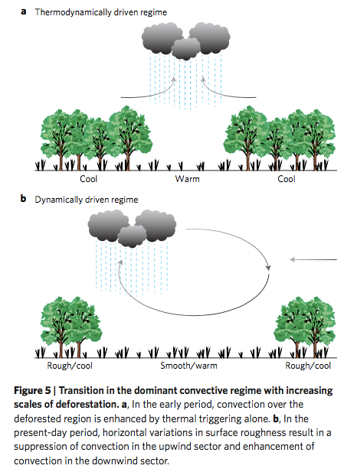
(Khanna et al, 2017)
Amazon deforestation leads to dry season climate change.
Deforestation is sufficiently advanced to have caused a shift from a thermally to a dynamically driven hydroclimatic regime – see figure. Used satellite data to confirm this.
They showed that cloud and precipitation “dipole” shapes increased over time. Downwind of deforested areas, experience wetting; whereas upwind areas experience drying.

Slide 15
(Huntingford et al, 2013)
Simulated resilience of tropical rainforests to CO2-induced climate change.
There are three forcings that affect forest biomass: (1) precipitation change causes slight decrease in biomass (2) temperature causes decrease in biomass (3) carbon dioxide causes high increase in biomass. Overall, carbon dioxide effect is greatest and therefore biomass increases
Forest biomass has increased with increasing atmospheric carbon dioxide, and is projected to continue this trend
We have to look at all three forcings and their effect on our hydroclimatic indeces?
(Guan et al, 2018)
Looked at sensitivity of African ecosystem to rainfall frequency, intensity, and rainy season length
Rainy season length was the biggest impact on “gross primary production”, more than frequency and intensity of rain were
Three different productivity responses to seasonal rainfall variability: (1) chronic water stress in the savannas, (2) acute water stress in the woodlands; (3) minimum water stress in tropical forests
Used a vegetation model and stochastic rainfall generator to study how different biomes respond to shifts in the rainfall parameters
(Arvor et al, 2014)
Used TRMM precipitation and agricultural maps to prove that adoption of intensive agricultural practices such as double cropping systems is partly the result of adaptation of local climate conditions
Look at this paper for an agriculturally relevant way to define the dry season.

Slide 16
(Duveiller et al, 2018)
Changing vegetation cover alters surface energy balance and can lead to either warming or cooling. Conversion of forests to grasslands increases albedo but decreases ET, which can lead to warming or cooling depending on which process dominates
Temperature increases due to agricultural expansion in the tropics, where surface brightening decreases net radiation but doesn’t counter balance the increase in temperature associated with a decrease in transpiration.
The paper has a huge chart of potential change in T and surface energy balance depending on various transitions in vegetation type. Can’t we just use this to talk about the heat index part? Do we need to pinpoint specific locations?
Is this land use -> climate project an exercise in lit review of existing methods and applying them, or coming up with our own stat model?
Are we trying to calculate the hydroclimate metrics before and after land use change?
(Li and Fu, 2003)
Describes the transition from dry to wet season in Amazonia in very scientific language; didn’t understand but seems to have good background about climate in the region

